Slide 1
8254 Timer

Slide 2
Features of 8254 Timer
It has 3 independent 16 bit down counters.
Counters can be programmed in 6 different modes.
Counting facility in both BCD and Binary number systems.
It has powerful command called READ BACK COMMAND which allows the user to check the count value,programmed mode and current mode and current status of the counter.
Operating frequency range is For 8253:- upto 2.6 MHz For 8254:- upto 10 MHz

Slide 3
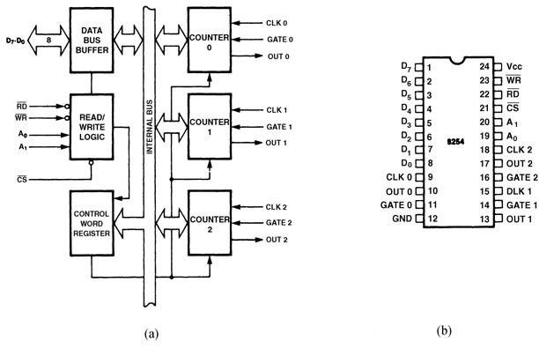

Slide 4
8254 Functional Description
 Figure shows the pin-out of the 8254,
a higher-speed version of the 8253, and a diagram of one of the three counters.
 Each timer contains:
 a CLK input which provides the basic operating frequency to the timer
 a gate input pin which controls the timer in some modes
 an output (OUT) connection to obtain the output of the timer

Slide 5
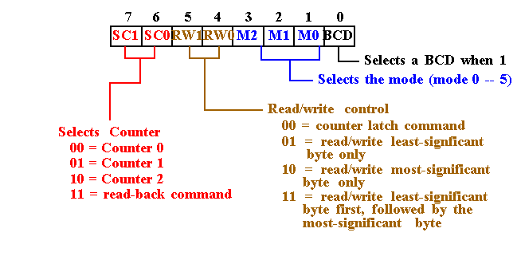
8254 Control word

Slide 6
8254 Programming

Each counter may be programmed with a count of 1 to FFFFH.

Minimum count is 1 all modes except 2 and 3 with minimum count of 2.

Each counter has a program control word used to select the way the counter operates.

If two bytes are programmed, then the first byte (LSB) stops the count, and the second byte (MSB) starts the counter with the new count.

Slide 7
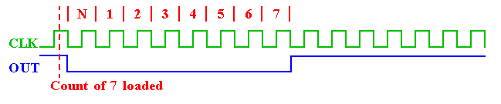
 Mode 0: Interrupt on terminal count
- The output becomes a logic 0 when the control word is written
-and remains there until N plus the number of programmed counts
-When the Gate goes low the counter pauses. It resumes when Gates becomes high again

Slide 8
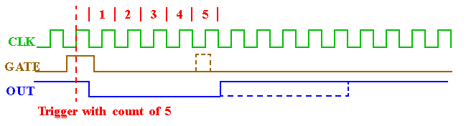
MODE 1:- Hardware retrigger able one shot.
The triggering must be done through the GATE input by sending a 0-to-1 pulse to it.
Steps:
Load the count register
A 0-to-1 pulse must be sent to the GATE input to trigger the count.
In Mode 1, after sending the 0-to-1 pulse to GATE, OUT becomes low and stays low for a duration of N*T, then becomes high and stays high until the GATE is triggered again.
If during the activation, a retriggered happened, then restart the down counting.

Slide 9
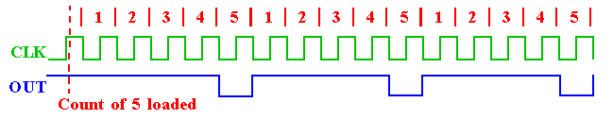
Mode 2: Rate Generator (Divide-by-N counter

In Mode2, if GATE=1, OUT will be high for N*T, goes low only for one clock pulse, then counter is reloaded automatically,
The cycle is repeated until reprogrammed or G pin set to 0. Count =1 is illegal in this mode.



Slide 10
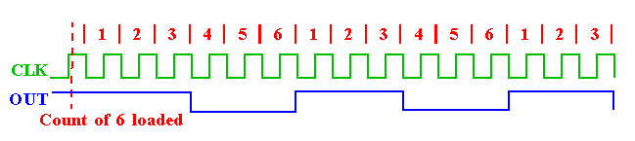
Mode 3: Square wave rate generator


Mode 3: Generates a continuous square-wave with G set to 1.
If count is even, 50% duty cycle otherwise OUT is high 1 cycle longer
High for (n+1)/2 & low for (n-1)/2 clock cycles


Slide 11
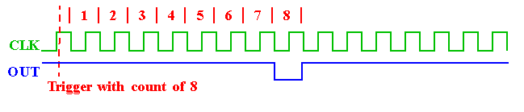
Mode 4: Software triggered strobe

In Mode4, if GATE=1, the output will go high when loading the count, it will stay high for duration N*T.
After the count reaches zero, it becomes low for one clock pulse, then goes high again and stays high until a new command word or new count is loaded
To repeat the strobe, the count must be reloaded



Slide 12
Mode 5: Hardware triggered strobe
 Similar to Mode4, except that the triggering must be done with the GATE input
 The count starts only when a 0-to-1 pulse is sent to the GATE input
 If GATE retriggered during the counting, it will restart the down counting

Slide 13
Read Operations
There are three possible methods for reading the counters:
a simple read operation
the Counter Latch Command
the Read-Back Command
1. Simple read operation :
The Counter which is selected with the A1, A0 inputs, the CLK input of the selected Counter must be inhibited by using either the GATE input or external logic.
Otherwise, the count may be in the process of changing when it is read, giving an undefined result.

Slide 14
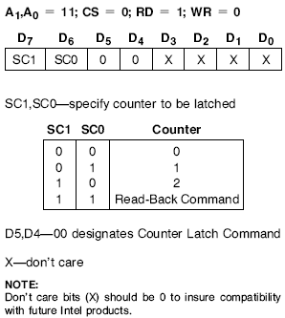
2. Counter Latch Command:
SC0, SC1 bits select one of the three counters
Two other bits, D5 and D4,
distinguish this command from a control word
If a counter is latched and then, some time later, latched again before the count is read, the second counter latch command is ignored.
The count read will be the count at the time the first counter latch command was issued.
➢
➢

Slide 15
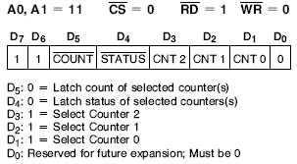
3. Read-back control command:
The read-back control, word is used, when it is necessary for the contents of more than one
➢
counter to be read at a same time.
Count : logic 0, select one of the Counter to be latched
Status : logic 0, Status must be latched to be read status of a counter and is accessed by a read from that counter

Slide 16
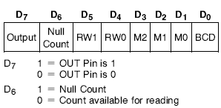
Status register:
Shows the state of the output pin
Check the counter is in null state (0) or not
How the counter is programmed

